Slide 1


Security Specialist Project
Secure Jetson Nano
ShinPark Team

Slide 2
1. Introduction
Jetson Nano Project
LGE security specialist Team 1 developed a Secure Jetson Nano for the project of ‘2021 LGE Security Specialist course’ in Carnegie Mellon University.
This document contains a security concept that aims to fulfill the security development process.
The secure Jetson Nano is developed to cover the following processes:
1. Asset Identification
2. Security Risk Assessment
3. Threat Analysis
4. Mitigation Threats
5. Security Requirements
6. Secure Coding
7. Static Analysis

Slide 3
1.1 Goal
Jetson Nano Project
Goal of secure Jetson Nano is based on 6 security characteristics.
Availability
Integrity
Authentication
Secure Jetson Nano
Confidentiality
Non-repudiation
Authorization

Slide 4
1.2 Role distribution
Jetson Nano Project
Role | Description | Name | Responsibility
Project Manager | Project Coordinator Schedule management | Jonghyun Park | Organize the team and manages project resources by planning. Manages the relationship with project stakeholder and mentor
Architect | System Design Implementation review | Sungjin Lee | Create strategy of system architecture development Detailed design of server and communication protocols
Developer | Definition protocol Implementation secure channel | Seokwang Kim Jaewon Lee | Have ownership of development server application
 | UX Design Client Application Protocol Design | Yeonbi Shin Sungsoo Kim | Detail design of client application
Tester | Create Test case Fuzz testing & Static Analysis | Jonghyun Park Sungjin Lee Jaewon Lee | Create test strategy and test cases Ensure the products meet standards of quality

Slide 5
1.3 Schedule
Jetson Nano Project
1 Week (Planning & Analysis)
- Project Planning
- Team Role Assignment
- System Architecture & Requirement
- Risk Assessment
- Threat Analysis
- Functional Requirement
- Quality Attribute
2 Week (Analysis & Design)
- Security Requirement
- Mitigation
- Overall Architecture Design
- Protocol Design
- Sample code analysis
- Secure Design
- Server and Client Implementation
- Test case
- Implementation
3 Week (Implementation & Test)
- Secure coding
- Interoperability test
- Static Analysis
- Test
- Modification
- Packaging
- Release
- Presentation

Slide 6
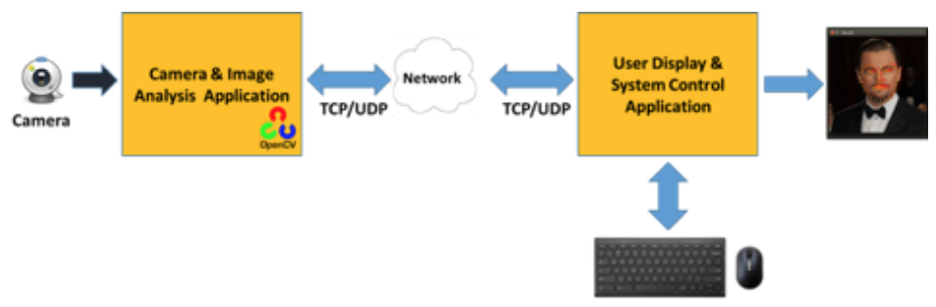
2. System Architecture
Jetson Nano Project
 | Jetson Nano | Client
HW | Jetson Nano Board Camera module | PC
Interface | Wi-Fi USB | Wi-Fi
OS | Ubuntu 18.04 | Windows 10
SW Module | FaceRecDemoTCP | RecvImageTCP
Data | Video Stream Captured Image User ID/PW | Video Stream Captured Image User ID/PW

Slide 7
2.1 Sequence Diagram
Jetson Nano Project
User connect the Jetson Nano through SSH using specified ID/PW.
Jetson Nano uses a camera to collect image frames and analyzes them with artificial intelligence (AI) to implement face detection and recognition.
After the video frame is analyzed, the additional amplification information obtained from the analysis is sent to the user display and system control application.
The user display and system control application get the information from Jetson Nano and display it.
Camera
Jetson Nano
Web Client
(1) Connection request
(2) Connection accept
(3) Collect image Frame
(4) Send amplification information

Slide 8
2.2. System Requirements
Jetson Nano Project
Basic system requirements without considering security aspects.
Part | No. | Requirement
General | RQ-GEN-01 | Server and client should communicate normally.
 | RQ-GEN-02 | Secure or non-secure mode should be implemented between the server and the client.
 | RQ-GEN-03 | The status of connection should be reported (eg. fault/error detection, recovery, etc)
Jetson Nano (Server) | RQ-SVR-01 | Server should be run as Learning, Run, Test Run Mode.
 | RQ-SVR-02 | In learning mode, the name of the person in front of the camera should be input, registered in the DB, and the result should be transmitted to the client.
 | RQ-SVR-03 | In Run Mode, the server should perform face recognition using the camera and transmit the result to the client.
 | RQ-SVR-04 | In Test Run Mode, face recognition should be performed using the given video file and the result should be transmitted to the client.
 | RQ-SVR-05 | The server should be able to map multiple photos of a user to a single ID.
 | RQ-SVR-06 | The server must listen to the Secure/Non Secure port for secure communication.
PC (Client) | RQ-CLI-01 | In the client authentication screen, the SW should provide a UI that determines the Secure/Non Secure mode among the communication methods with the server.
 | RQ-CLI-02 | The client SW should provide a UI that determines the operation mode of the server - Learning, Run, Test Run Mode.
 | RQ-CLI-03 | In learning mode, the client must pass the username as input to the server .

Slide 9
3. Asset Identification
Jetson Nano Project
Asset of Jetson Nano?
Things attackers want
Things you want to protect
Stepping stones to either of these
Part | No. | Asset
HW | Asset-HW-01 | Camera
 | Asset-HW-02 | Jetson Nano
 | Asset-HW-03 | PC
SW | Asset-SW-01 | User Information
 | Asset-SW-02 | Face Data Base
 | Asset-SW-03 | Image Information data (name, count, etc)
 | Asset-SW-04 | Control system data (mode, error, etc)

Slide 10
4. Risk Assessment
Jetson Nano Project
Identify project risks
RISK ID | Condition | Consequence | Probability | Impact | Rating
RSK-01 | Noise data from the network | The control system cannot quickly set the normal data. | 9 | 2 | 18
RSK-02 | Replay attack for Network communication | Attacker can use old packet for replay attack | 5 | 10 | 50
RSK-03 | Data flow sniffing | Attacker can see the data from camera to control system | 7 | 8 | 56
RSK-04 | Someone stole Jetson Nano board | The project will be stopped, and it takes a long time to buy a new one. | 2 | 5 | 10
RSK-05 | Face image and names stored in DB leaked | Personal information leakage | 3 | 7 | 21
RSK-06 | The network packet between the Jetson Nano board and the client pc is sniped | Information from DB data is leaked and hacker can be tricked into a registered member and access is successful. | 9 | 9 | 81
RSK-07 | One of your team members is ill or infected with Covid-19. Vacation due to emergency. | The patient could not participate in the project until fully recovered, increasing the stress on the remaining members. In the worst case, schedule delays or reduced project completion | 6 | 7 | 42
RSK-08 | Jetson Nano board or camera module is physically broken | Project cannot be completed because there is no replacement HW | 5 | 10 | 50
RSK-09 | Lost or broken development PC | Work is delayed | 2 | 6 | 12
RSK-10 | Design or threat modeling that differs from project goals | Failed to submit project results and must be completely redesigned and redeveloped | 3 | 8 | 24
RSK-11 | Saved DBs can be tampered with by hackers. | Security cameras recognize faces differently. For example, consider A as B. | 2 | 10 | 20
RSK-12 | Normal user get administrator right (root privilege) and change the system. | A normal user can put a malicious backdoor on behalf of the normal system. | 3 | 10 | 30
RSK-13 | Jetson Nano responds that it did not receive the data sent by the client. | The mode setting data sent by the client cannot be transmitted and may be set to another mode. | 3 | 8 | 24

Slide 11
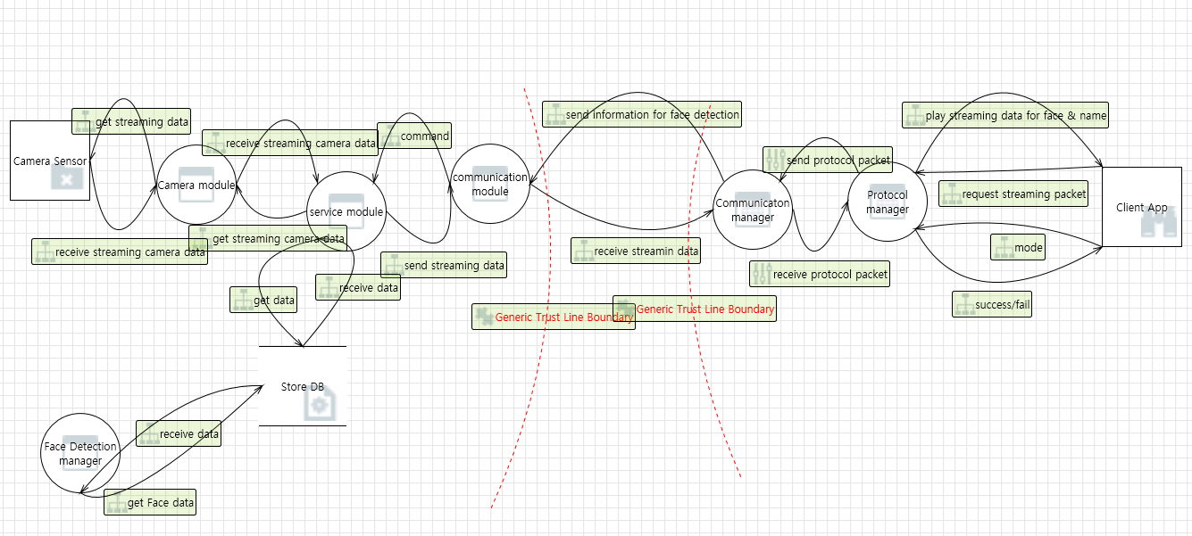
5. Threat Analysis
Jetson Nano Project
DFD for Threat Analysis

Slide 12
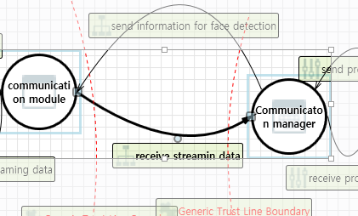
5.1 Threat modeling - STRIDE
Jetson Nano Project
Interaction Part | Category | Description | Asset No.
 | Tampering | If communication module is given access to memory, such as shared memory or pointers, or is given the ability to control what Communication manager executes (for example, passing back a function pointer.), then communication module can tamper with Communication manager. Consider if the function could work with less access to memory, such as passing data rather than pointers. Copy in data provided, and then validate it. | Asset-SW-01 Asset-SW-02 Asset-SW-03 Asset-SW-04
 |  | Data flowing across send information for face detection may be tampered with by an attacker. This may lead to a denial of service attack against communication module or an elevation of privilege attack against communication module or an information disclosure by communication module. Failure to verify that input is as expected is a root cause of a very large number of exploitable issues. Consider all paths and the way they handle data. Verify that all input is verified for correctness using an approved list input validation approach.
 |  | Data flowing across receive streaming data may be tampered with by an attacker. This may lead to a denial of service attack against Communication manager or an elevation of privilege attack against Communication manager or an information disclosure by Communication manager. Failure to verify that input is as expected is a root cause of a very large number of exploitable issues. Consider all paths and the way they handle data. Verify that all input is verified for correctness using an approved list input validation approach.
 | Spoofing | Communication manager may be spoofed by an attacker and this may lead to unauthorized access to communication module. Consider using a standard authentication mechanism to identify the source process.
 |  | communication module may be spoofed by an attacker and this may lead to information disclosure by Communication manager. Consider using a standard authentication mechanism to identify the destination process.
 |  | communication module may be spoofed by an attacker and this may lead to unauthorized access to Communication manager. Consider using a standard authentication mechanism to identify the source process.
 |  | Communication manager may be spoofed by an attacker and this may lead to information disclosure by communication module. Consider using a standard authentication mechanism to identify the destination process.
 | Repudiation | Communication manager claims that it did not receive data from a source outside the trust boundary. Consider using logging or auditing to record the source, time, and summary of the received data.
 |  | communication module claims that it did not receive data from a source outside the trust boundary. Consider using logging or auditing to record the source, time, and summary of the received data.

Slide 13
5.1 Threat modeling - STRIDE
Jetson Nano Project
Interaction Part | Category | Description | Asset No.
 | Information Disclosure | Data flowing across receive streaming data may be sniffed by an attacker. Depending on what type of data an attacker can read, it may be used to attack other parts of the system or simply be a disclosure of information leading to compliance violations. Consider encrypting the data flow.
 |  | Data flowing across send information for face detection may be sniffed by an attacker. Depending on what type of data an attacker can read, it may be used to attack other parts of the system or simply be a disclosure of information leading to compliance violations. Consider encrypting the data flow.
 | Elevation Of Privilege | An attacker may pass data into Communication manager in order to change the flow of program execution within Communication manager to the attacker's choosing.
 |  | communication module may be able to remotely execute code for Communication manager.
 |  | An attacker may pass data into communication module in order to change the flow of program execution within communication module to the attacker's choosing.
 |  | Communication manager may be able to remotely execute code for communication module.
 |  | Communication manager may be able to impersonate the context of communication module in order to gain additional privilege.
 |  | communication module may be able to impersonate the context of Communication manager in order to gain additional privilege.
 | Denial Of Service | An external agent interrupts data flowing across a trust boundary in either direction.
 |  | Communication manager crashes, halts, stops or runs slowly; in all cases violating an availability metric.
 |  | An external agent interrupts data flowing across a trust boundary in either direction.
 |  | communication module crashes, halts, stops or runs slowly; in all cases violating an availability metric.

Slide 14
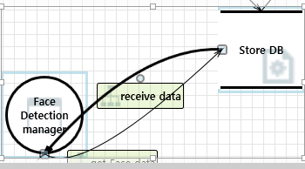
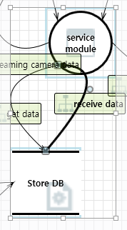
5.1 Threat modeling - STRIDE
Jetson Nano Project
Interaction Part | Category | Description | Asset No.
 | Spoofing | Store DB may be spoofed by an attacker and this may lead to incorrect data delivered to Face Detection manager. Consider using a standard authentication mechanism to identify the source data store. | Asset-SW-02 Asset-SW-03
 |  | Store DB may be spoofed by an attacker and this may lead to data being written to the attacker's target instead of Store DB. Consider using a standard authentication mechanism to identify the destination data store.
 | Information Disclosure | Improper data protection of Store DB can allow an attacker to read information not intended for disclosure. Review authorization settings.
 | Denial Of Service | Does service module or Store DB take explicit steps to control resource consumption? Resource consumption attacks can be hard to deal with, and there are times that it makes sense to let the OS do the job. Be careful that your resource requests don't deadlock, and that they do timeout.
 | Spoofing | Store DB may be spoofed by an attacker and this may lead to incorrect data delivered to service module. Consider using a standard authentication mechanism to identify the source data store. | Asset-SW-01 Asset-SW-04
 | Information Disclosure | Improper data protection of Store DB can allow an attacker to read information not intended for disclosure. Review authorization settings.
 | Denial Of Service | Does Face Detection manager or Store DB take explicit steps to control resource consumption? Resource consumption attacks can be hard to deal with, and there are times that it makes sense to let the OS do the job. Be careful that your resource requests don't deadlock, and that they do timeout.

Slide 15
6. Mitigations
Jetson Nano Project
Categorizing each risks according to the STRIDE and perform mitigation measure on them.
Risk ID | Condition | Threat Category | Mitigation method
RSK-01 | Noise data from the network | Denial Of Service | Network size limitation - Protocol manager to analyze and respond to large network packet size attacks quickly and efficiently.
RSK-02 | Replay attack for Network communication | Spoofing | Time stamp for Network packet - New time stamp for communication data
RSK-03 | Data flow sniffing | Information Disclosure | TLS applies - TLS 1.3 with wolfSSL - After TLS session, all transmitted data becomes encrypted.
RSK-05 | Face image and names stored in DB leaked | Tampering | TLS applies - TLS 1.3 with wolfSSL - After TLS session, all transmitted data becomes encrypted.
RSK-06 | The network packet between the Jetson Nano board and the client pc is sniped | Tampering | TLS applies - TLS 1.3 with wolfSSL - After TLS session, all transmitted data becomes encrypted.
RSK-11 | Saved DBs can be tampered with by hackers. | Tampering | Data encryption - AES_128_CBC - SHA_256
RSK-12 | Normal user get administrator right (root privilege) and change the system. | Elevation Of Privilege | Minimum privileges for user - applying the minimum necessary privileges of file access to each user Close unused ports - Network ports should be blocked by default and only allowed if they are really needed for legitimate connections
RSK-13 | Jetson Nano responds that it did not receive the data sent by the client. | Repudiation | Request and Response - Check the request and the appropriate response message - Re-request if there is no expected response
RSK-14 | Attackers create so many connections that Jetson Nano cannot handle | Denial Of Service | Apply Firewall to Jetson Nano - Drop all connection except serviced port - Add DoS attack defences

Slide 16
7. Security Requirements
Jetson Nano Project
Requirement ID | Descriptions | Related Risk ID
RQ-SEC-GEN-01 | Authenticated communication should be implemented between server and client. | RSK-02 RSK-03 RSK-05 RSK-06 RSK-11
RQ-SEC-GEN-02 | Secure mode should be implemented between server and client.
RQ-SEC-GEN-03 | In secure mode, all of data should be encrypted including time stamp.
RQ-SEC-GEN-04 | The server and the client must send and receive a request/response in the form of a message specified in the communication protocol. | RSK-13
RQ-SEC-SVR-01 | In learning mode, the name of the person in front of the camera and the number of images to be collected must be input and registered in the DB. | RSK-01 RSK-11
RQ-SEC-SVR-02 | In learning mode, images must be saved according to the number of images given. | RSK-01 RSK-11
RQ-SEC-SVR-03 | Test Run Mode should not allow files other than the given video files. | RSK-01 RSK-11
RQ-SEC-SVR-04 | The server must only allow the authenticated user can access the system through the authentication process including user ID/PW. | RSK-03 RSK-06
RQ-SEC-SVR-05 | The server should store the user's ID, password, and authority in the DB. | RSK-03 RSK-06 RSK-12
RQ-SEC-SVR-06 | The server must close the socket when authentication fails. | RSK-02 RSK-03 RSK-05 RSK-06 RSK-11
RQ-SEC-SVR-07 | When the server is connected to either the secure port or the non-secure port, the other port must be closed.
RQ-SEC-SVR-08 | Only server administrator can change DB data of server. | RSK-12
RQ-SEC-SVR-09 | The server must not be hang or crash due to an external DoS attack. | RSK-14
RQ-SEC-CLI-01 | In learning mode, the client receives and transmits the number of images to be collected along with the user name. | RSK-01 RSK-11
RQ-SEC-CLI-02 | The client should provide a UI to register the user ID/PW with the server. | RSK-03 RSK-06
RQ-SEC-CLI-03 | The client must provide a UI to login to the server. | RSK-12

Slide 17
8. Quality Attributes Scenarios
Jetson Nano Project
Security-related quality attribute scenarios
QA ID | Category | QA Six parts | Description | Related Requirement
SEC-QA1 | Confidentiality | Stimulus | Attempt to intercept packets between server and client | RQ-SEC-GEN-01 RQ-SEC-GEN-02 RQ-SEC-GEN-03
 |  | Source | Attacker in the middle
 |  | Environment | Normal network communication between server & client
 |  | Artifact | All data include user ID/PW & image data
 |  | Response | Data encryption
 |  | Response measure | 100% encrypted data When a tester capture the packet and check the contents, he should not be able to guess the contents of the packet at all.
SEC-QA2 | Availability | Stimulus | Disguise someone’s identity with stolen credentials (ID/PW) | RQ-SEC-SVR-04
 |  | Source | Attacker disguised as a normal user
 |  | Environment | Normal log in operation
 |  | Artifact | User data from server
 |  | Response | 2-factor authentication
 |  | Response measure | Reject login attempts in case of 2-factor authentication failure Even if the password is stolen, the server must be able to verify that the accessor is a user with valid privileges. 2fa authorized users must be 100% loginable.
SEC-QA3 | Integrity | Stimulus | Attempt to change DB data of server | RQ-SEC-SVR-05 RQ-SEC-SVR-08
 |  | Source | General user to gain administrator privileges
 |  | Environment | General user access
 |  | Artifact | All data in DB
 |  | Response | Prohibition of escalation of privileges from general user to administrator in the system
 |  | Response measure | Re-execution of administrator authentication procedure when accessing user DB

Slide 18
9. Secure System Design Architecture
Jetson Nano Project
Jetson Nano
Client
Display Manager
Protocol Manager
Protocol Manager
Mode Control Manager
Firewall
Face Detection Manager
Service Manager
Communication Manager
Communication Manager
User Input Manager
Data
Manager
Authentication Manager
Authentication Manager
Display Manager
DB
SDB
Security Manager
Secure channel
New Component
Modified Component

Slide 19
10. Security Design for Security Requirement
Jetson Nano Project
Security Design ID | Descriptions | Related Requirement ID
SD-01 | Implementation of ‘Secure mode’ using TLS 1.3 | RQ-SEC-GEN-02, RQ-SEC-GEN-03
SD-02 | Implementation of ‘Protocol Manager’ module based on necessary data format | RQ-SEC-GEN-04
SD-03 | Separation of administrator privilege to manage DB in learning mode | RQ-SEC-SVR-01, RQ-SEC-SVR-02 RQ-SEC-SVR-08
SD-04 | Implemented a limited user operation | RQ-SEC-SVR-03, RQ-SEC-SVR-08
SD-05 | Implementation of ‘Authentication Manager’ module based on authentication process | RQ-SEC-SVR-04
SD-06 | Separation of ‘Authentication Manager’ domain to store credential data (user's ID/PW, authority) | RQ-SEC-SVR-05
SD-07 | Modification of ‘Communication Manager’ to implement secure mode | RQ-SEC-SVR-06, RQ-SEC-SVR-07
SD-08 | Apply Firewall | RQ-SEC-SVR-09
SD-09 | UI design considering secure mode | RQ-SEC-CLI-01, RQ-SEC-CLI-02 RQ-SEC-CLI-03
Jetson Nano
Client
SD2
SD2
SD9
Display Manager
Protocol Manager
Protocol Manager
Mode Control Manager
SD4
SD7
Firewall
SD1
SD7
Face Detection Manager
Service Manager
Communication Manager
Communication Manager
User Input Manager
Data
Manager
Authentication Manager
SD8
Authentication Manager
Display Manager
DB
SD6
SD3
SDB
Security Manager
SD5
Security Design ID

Slide 20
10.1 Security Major Design Points
Jetson Nano Project
Apply TLS 1.3
For the Secure Communication(All data encrypted between Server and Client)
Provide mutual authentication through public key certificates
Provide message integrity
Design our own application protocol
Server & Client only processing msg&data encapsulated by our own protocol
Checking valid value & length each field for preventing tampering attack
Add User Authentication
ID/PW based
User DB encrypted
Prevent information disclosure
Separate permissions based on user type
Administrator only can run learning mode
Face data encrypted & stored by SQL for preventing information disclosure
Apply Firewall
Block unauthorized connections
Defense Dos Attack

Slide 21
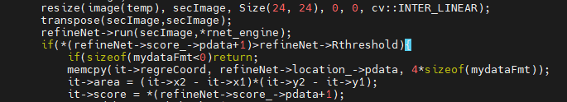
11. Secure Coding Rule - CWE
Jetson Nano Project
Secure Jetson Nano project follows ‘CWE’ C code standards using ‘flawfinder’ tool
https://cwe.mitre.org/data/definitions/699.html
violation
modification

Slide 22
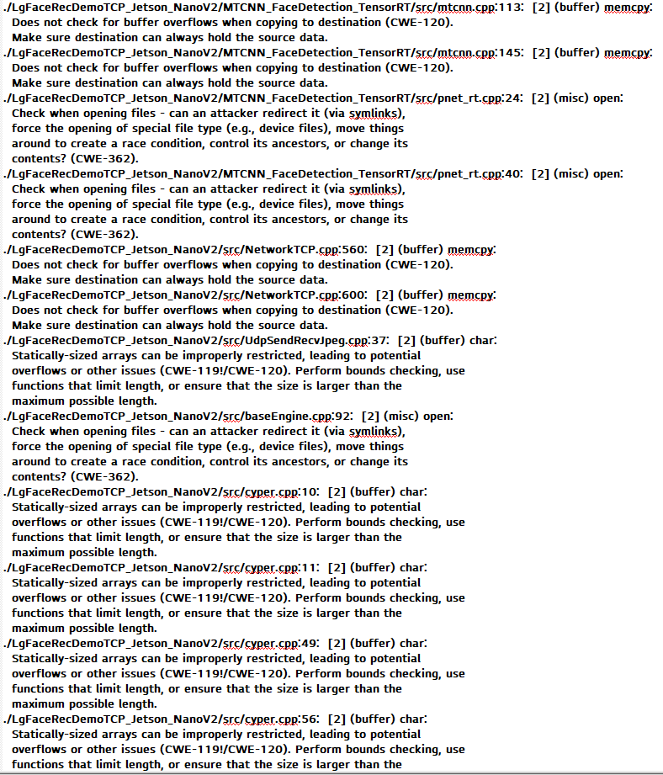
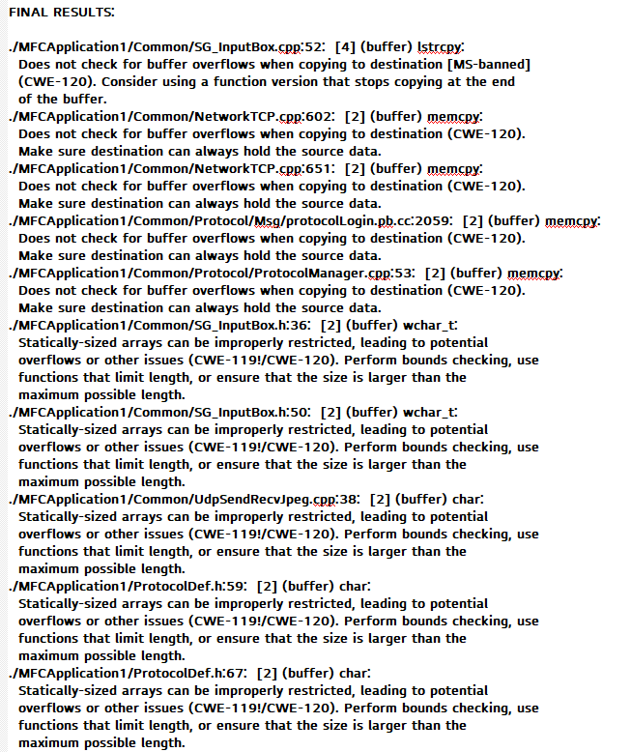
12. Static Analysis - flawfinder
Jetson Nano Project
Verification of Secure Coding using ‘flawfinder’ tool
Server
Client

Slide 23
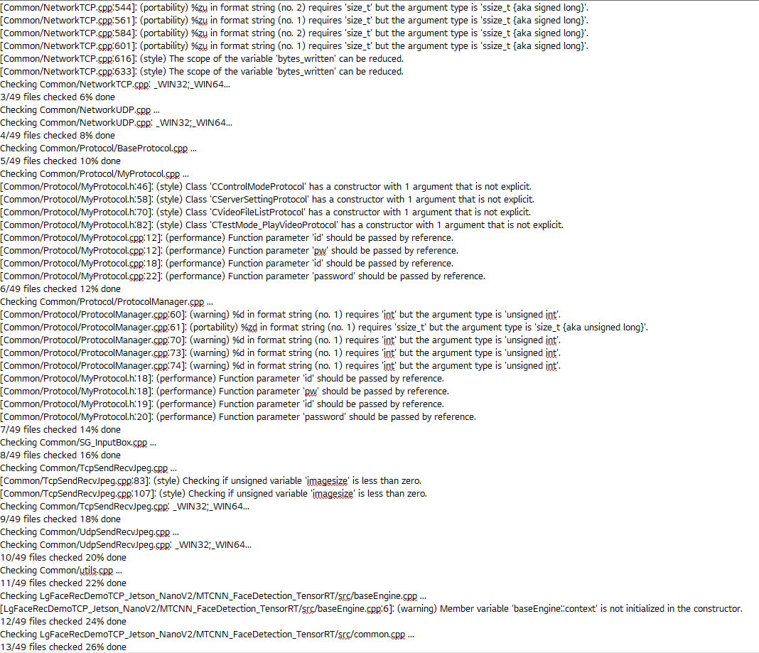
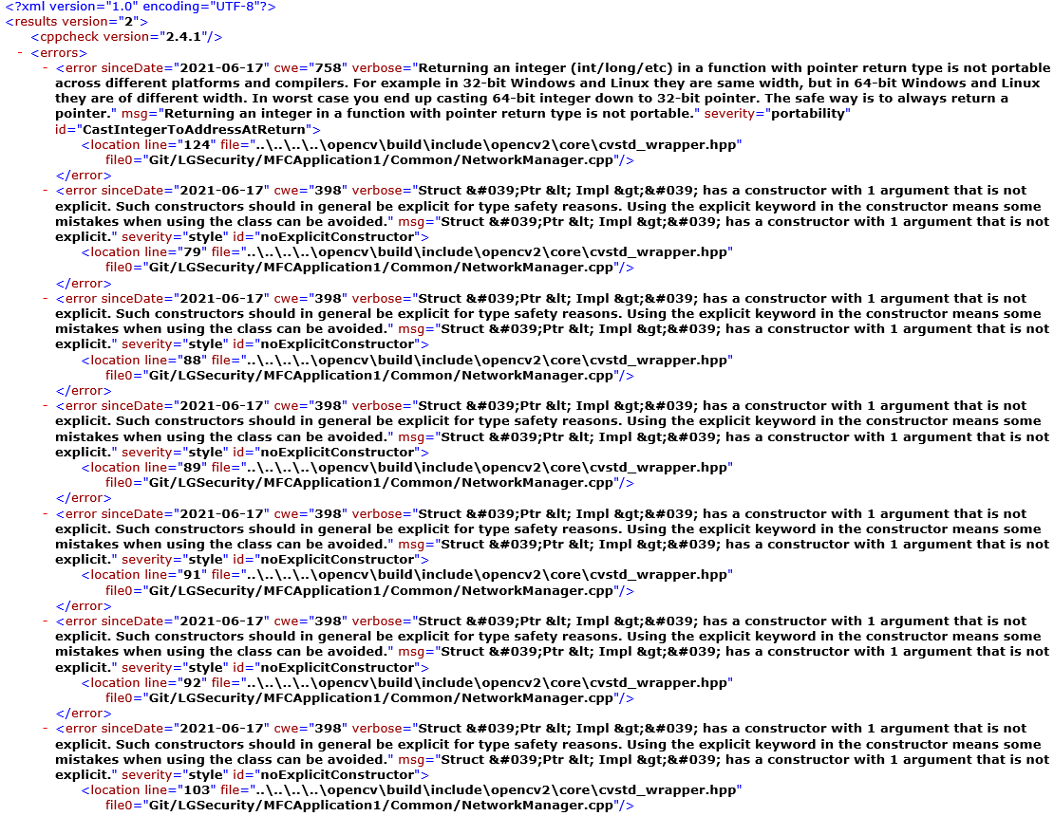
12. Static Analysis - cppcheck
Jetson Nano Project
Static Analysis using ‘cppcheck’ tool
Server
Client

Slide 24
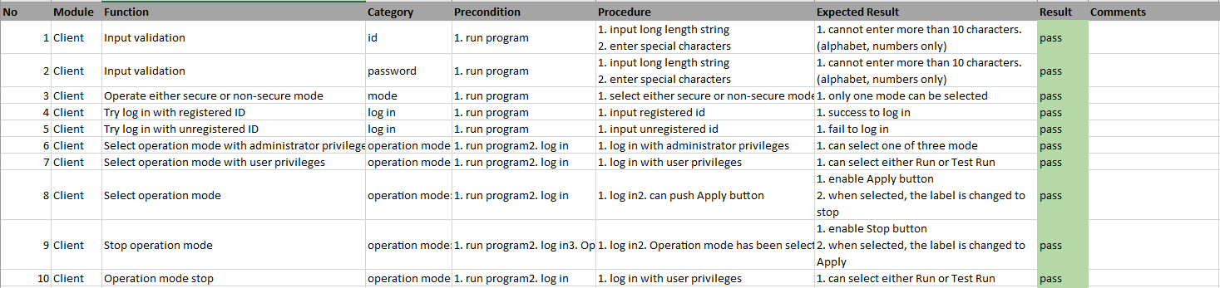
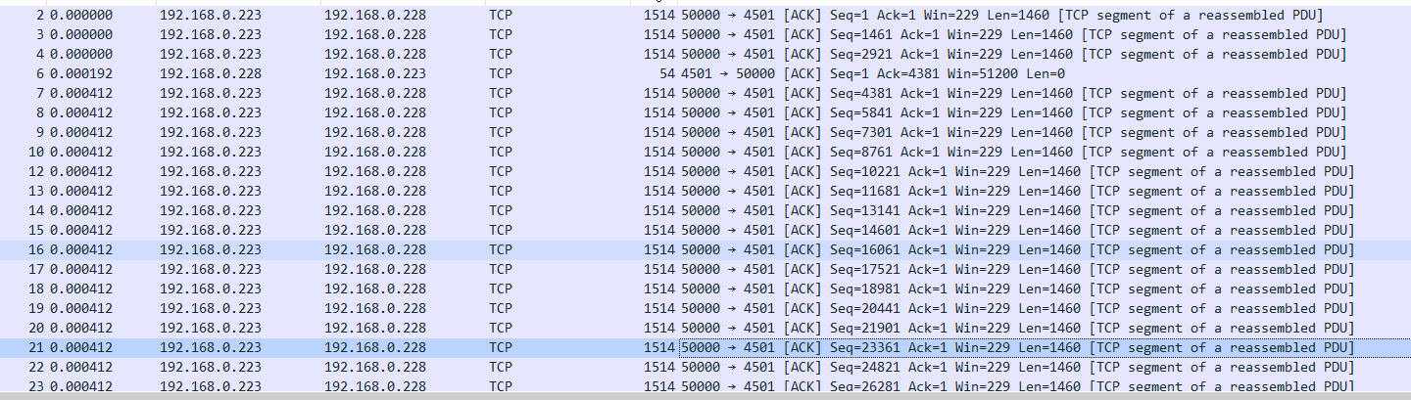
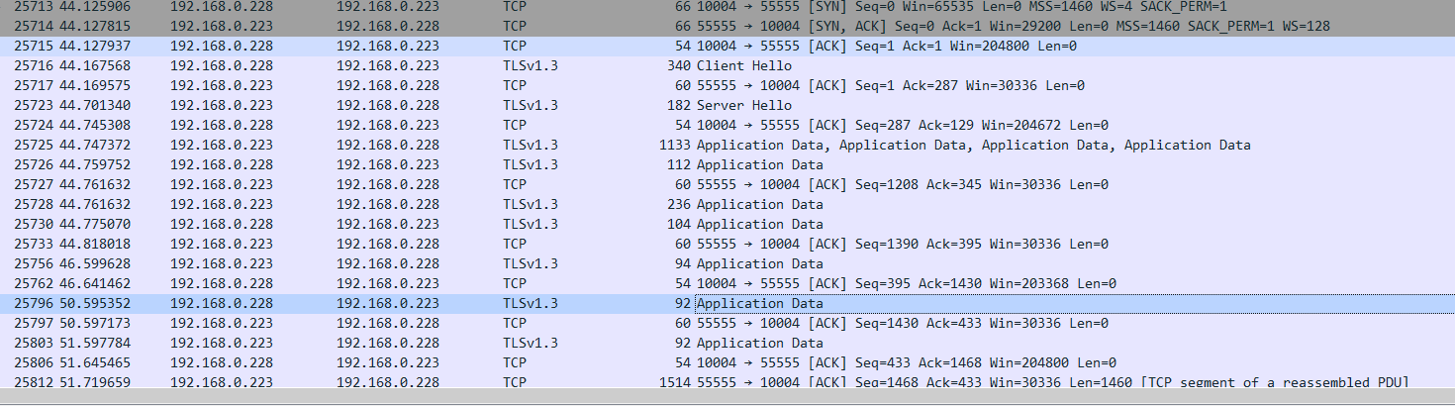
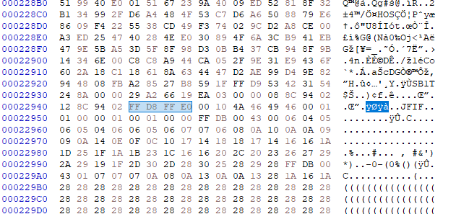
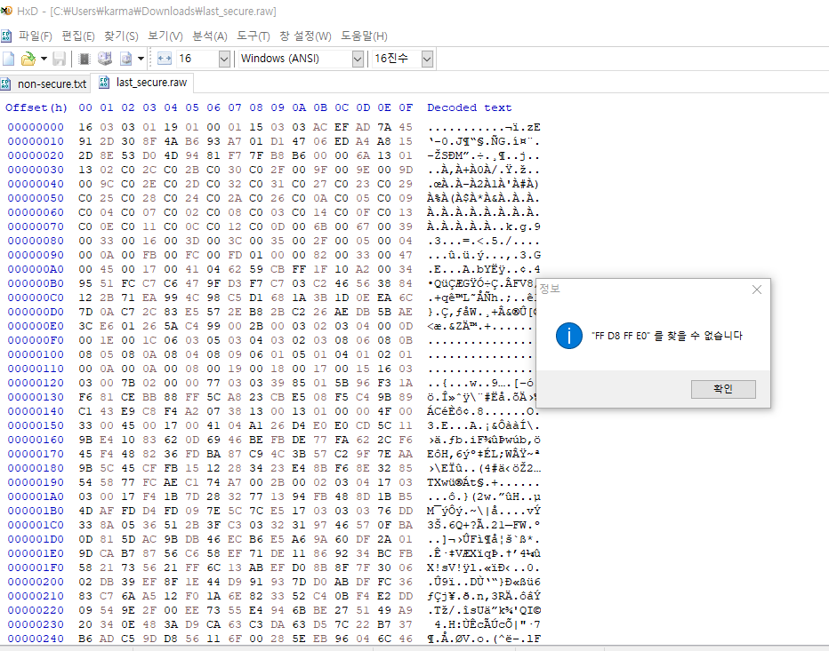
13. Testing
Jetson Nano Project
Design 24 testcases & Run test
Result : 24 Pass, 0 Fail (https://drive.google.com/file/d/1avvoxG8JM5V3aDeXzDjdWqXfNR5TAA3E/view?usp=sharing)
Testing example
Connection is not secure in Non-Secure mode
Attacker is able to get JPG in the middle
Connection is protect by TLS 1.3 in Secure mode
Attacker can`t get JPG in the middle

Slide 25
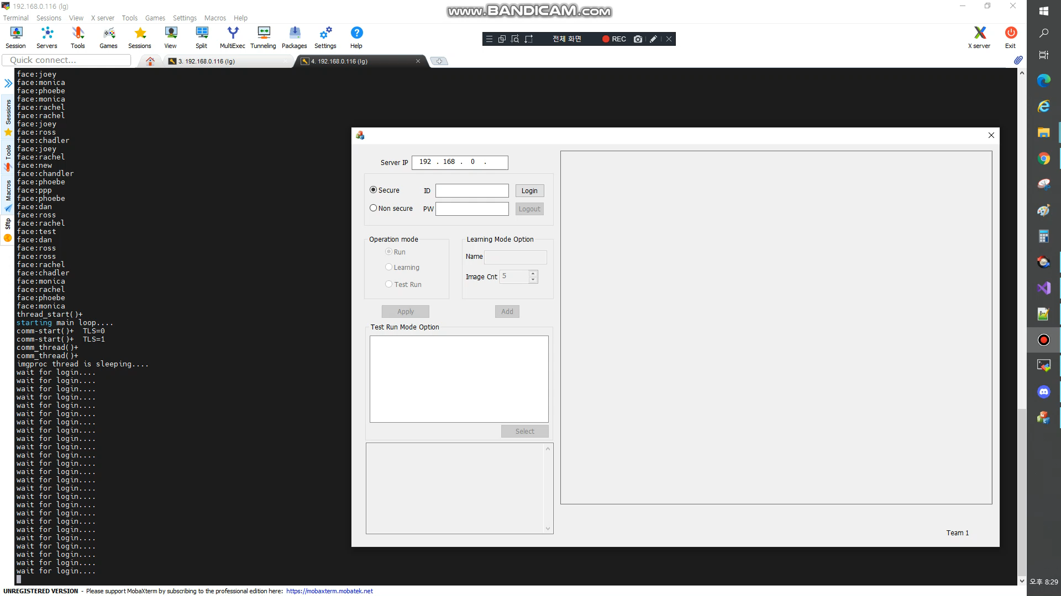
13. Demo of system
Jetson Nano Project

Slide 26
14. Lessons and Learned
Jetson Nano Project
Lesson | Activities | Learned
Asset Identification | Identifying assets Things attackers want Things you want to protect Stepping stones to either of these | Good: Knowing the assets that actually need to be protected can make an effort to constantly improve the quality of developments.
Security Risk Assessment | Brainstorming Security Risk and Rating 3 points of view Sniffing data flow Attack network communication Tampering DB data | Good: Listing the different scenarios of risk can have makes it clear what tasks need to be done Bad: Difficult to define exact criteria for scoring
Threat Analysis | Analysis threat using MS Threat modeling tool Drawing DFD Define Trust boundaries Categorizing threats with STRIDE | Good: The vague risk becomes clear through the tool Bad: Difficult to define exact criteria for scoring
Mitigation Threats | Establishing Threat Mitigation Plans Relay attack – add New time stamp Sniffing Data flow → TLS 1.3 with wolfSSL Tampered DBs → AES_128_CBC data encryption Elevation of Root privilege → minimum privileges for user Attacking many connections → Drop all except serviced port | Good: Possible to investigate various threat mitigation measures. Bad: Many of the mitigation measures initially determined were not implemented due to time reasons.
Security Requirements & Quality Attributes | Describe new security requirements and considering QA Confidentiality Integrity Availability | Good: Can guarantee security requirement with confidentiality, integrity, availability through Quality attribute process Bad: The boundary between requirements and QA was ambiguous, so it was not possible to accurately distinguish them.
Secure Coding & Static Analysis | Reviewing c++ code standard and selecting tool OWASP CERT CWE Misra-c selecting tool flawfinder cppcheck | Good: Being able to look at and review the standards of secure coding Bad: Difficult to apply the tool to the ARM-based device system. Not spending more time on static analysis

Slide 27
Appendix

Slide 28
Secure system Sequence Diagram #1
Jetson Nano Project
Case #1 set secure mode
Service
Manager
(server)
Protocol Manager
(server)
Communication Manager
(server)
Communication Manager
(client)
Protocol Manager
(client)
Mode Control Manager
(client)
(1) mode request
(2) Set protocol
(3) Response
(4) Send mode
(5) Set protocol
(6) Response
(7) Request mode
(8) Response
(9) Response
(10) Response

Slide 29
Secure system Sequence Diagram #2
Jetson Nano Project
Case #2 login process in secure mode
Crypto service
Manager
(server)
Data
Manager
(server)
Authentication Manager
(server)
Communication Manager
(server)
Communication Manager
(client)
Authentication Manager
(client)
User Input Manager
(client)
(1) login request
(2) Checking validation
(3) result response
(4) Send ID/PW
(5) Checking validation
(6) Read DB
(7) Request
(8) Response
(8) Response
(8) Response validation
(9) Response
(10) Response Acceptance

Slide 30
Secure system Sequence Diagram #3
Jetson Nano Project
Case #3 mode selection in secure mode
Authentication
Manager
(server)
Service Manager
(server)
Communication Manager
(server)
Communication Manager
(client)
Mode Control Manager
(client)
(1) mode request
(2) Send mode
(3) Request mode
(4) Checking validation
(5) Response
(6) Response
(7) Response
(8) Response

Slide 31
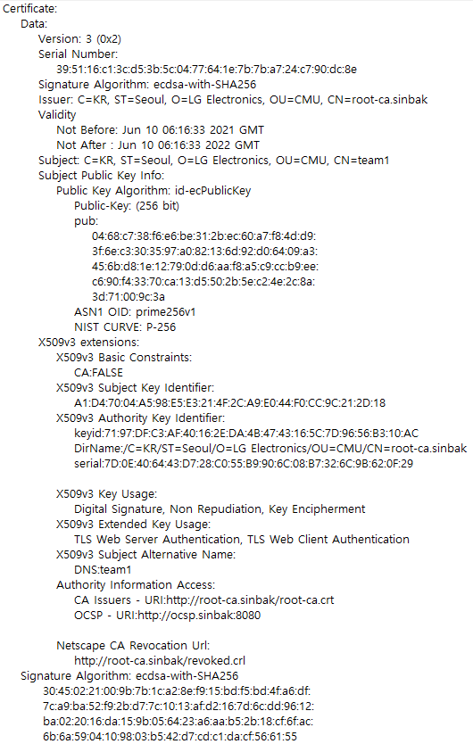
Security Design #1
Jetson Nano Project
No. | Requirement | Requirement No.
SD-01 | Implementation of ‘Secure mode’ using TLS 1.3 | RQ-SEC-GEN-02 RQ-SEC-GEN-03
 | Design | Remark
Library | Use wolfSSL 4.7.1 | * More useful in embedded ssl implementations(small, fast) * vulnerability free version (https://www.wolfssl.com/docs/security-vulnerabilities/)
TLS version | Only support 1.3 | * Weak cipher suites have been removed * All handshake messages after the ServerHello are now encrypted -> More Secure than prior version
Certificate | Generate Root-CA Certification, Server Certification | ECDSA prime256v1
Cipher suite | Only use TLS 1.3 Cipher suite | TLS_AES_256_GCM_SHA384. TLS_CHACHA20_POLY1305_SHA256. TLS_AES_128_GCM_SHA256. TLS_AES_128_CCM_8_SHA256. TLS_AES_128_CCM_SHA256.

Slide 32
Security Design #2
Jetson Nano Project
No. | Requirement | Requirement No.
SD-02 | Implementation of ‘Protocol Manager’ module based on necessary data format | RQ-SEC-GEN-04
HEADER
BODY
preamble
size
Time stamp
Msg type
protocol message
4 bytes
4 bytes
4 bytes
4 bytes
variable length
preamble
“SB1T”
msgtype
Login
Image
Mode Selection
Server Setting
Video File List
Video Select
Start Learning Mode
Msg Ack
protocol message : Google Protocol Buffers
Login | Id, Password
Image | Size, Jpeg data
Mode Selection | Secure / Plain
Server Setting | Initialize User DB / Face DB, Restart Server, Shutdown Server, Cam Start, Cam stop
Video File List | List of Videos
Video Select | Index of Selected Video
Start Learning Mode | Name, Number of Shots
Msg Ack | Ok / Not Ok
Notes:
The protocol of the Tartan system has the form above.
The HEADER part is composed as follows.
“preamble” to find the starting position of the stream
“size” field, which is the length of the entire packet,
“timestamp” for temporal validation of packet,
And, the “msg type” represents to the type of msg in the body.
Msg's body implemented various types of protocols using Google protocol buffer, which is easy to develop/debug and has good performance.
To prevent from tampering attacks on packets...
We strengthen the reliability by checking the size valid range of the packet, drop processing in case of timestamp rollback.
However, because it is difficult to fully defend in this way, we reviewed the application of packet encryption and TLS.

Slide 33
Security Design #3
Jetson Nano Project
No. | Requirement | Requirement No.
SD-03 | Separation of administrator privilege to manage DB in learning mode | RQ-SEC-SVR-01 RQ-SEC-SVR-02 RQ-SEC-SVR-08
Name, Number of Image
2. has authority?
Auth
Manager
1. check
authority
Service Manager
3. request
image
Face Detection
Manager
4. image
Security
Manager
5. request
encryption
DB
Manager
6. encrypted
image
Face DB

Slide 34
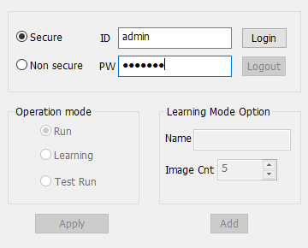
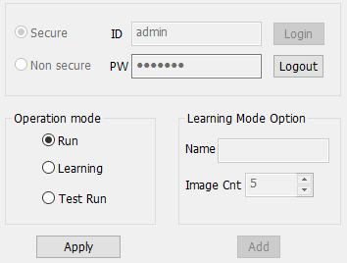

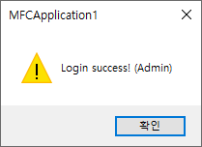
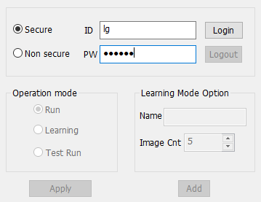
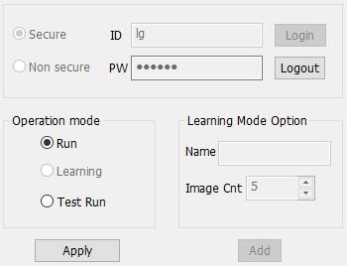
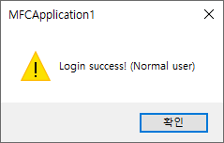
Security Design #4
Jetson Nano Project
No. | Requirement | Requirement No.
SD-04 | Implemented a limited user operation | RQ-SEC-SVR-03 RQ-SEC-SVR-08
Administrator
Activated
Normal user
Deactivated

Slide 35
Security Design #5,6
Jetson Nano Project
No. | Requirement | Requirement No.
SD-05 | Implementation of ‘Authentication Manager’ module based on authentication process | RQ-SEC-SVR-04
SD-06 | Separation of ‘Authentication Manager’ domain to store credential data (user's ID/PW, authority) | RQ-SEC-SVR-05
Authentication Manager
Domain
Service
Manager
Authentication
Manager
ID, Password
5. auth
1. id, pw
DB
Manager
2. id,
hashed pw
Security
Manager
4. auth
3. query
User DB

Slide 36
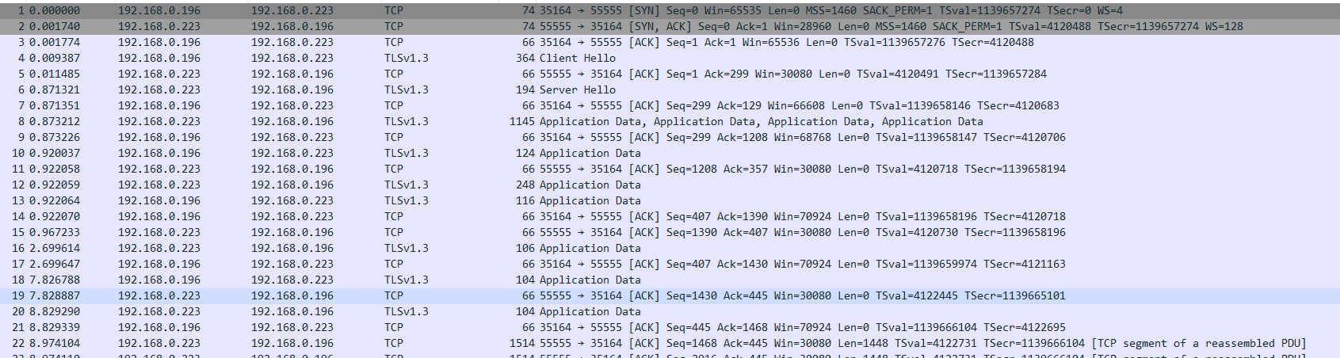
Security Design #7
Jetson Nano Project
No. | Requirement | Requirement No.
SD-07 | Modification of ‘Communication Manager’ to implement secure mode | RQ-SEC-SVR-06 RQ-SEC-SVR-07
S. Manager
S. Communication Manager
C. Communication Manager
C. Manager
TLS 1.3 handshake
Data(ID/PW, Mode, …)
Encrypted Data
Data(ID/PW, Mode, …)
Data(Status, JPG…)
Encrypted Data
Data(Status, JPG…)

Slide 37


Security Design #8
Jetson Nano Project
No. | Requirement | Requirement No.
SD-08 | Apply Firewall | RQ-SEC-SVR-09
Allow only TCP Ports
22, 50000, 55555
Normal Client
Jetson Nano
TCP Ports
22: SSH Service for Maintenance
50000: Service for Non-secure Mode
55555: Service for Secure Mode
Disallow
Malicious User

Slide 38
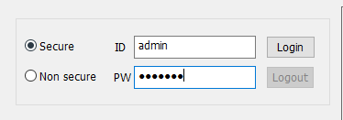
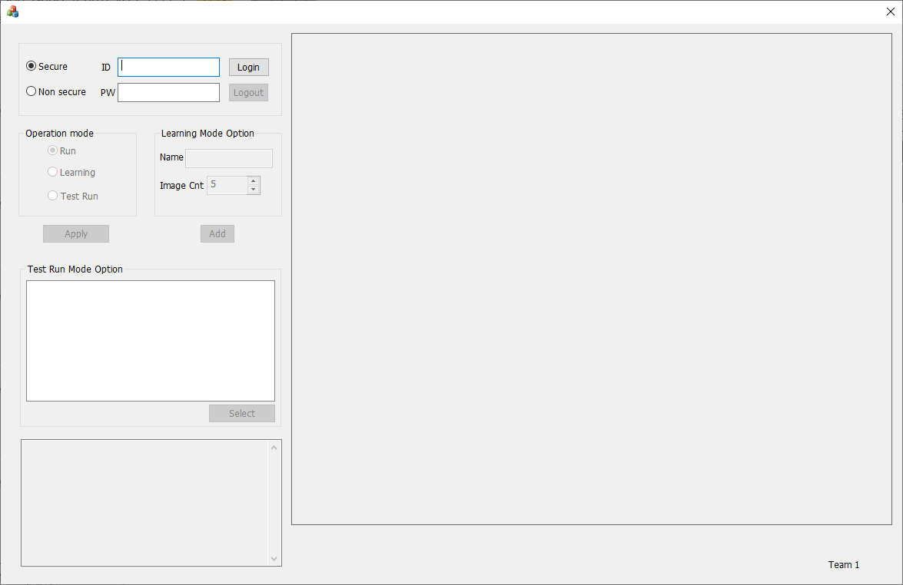
Security Design #9
Jetson Nano Project
No. | Requirement | Requirement No.
SD-09 | UI design considering secure mode | RQ-SEC-CLI-01 RQ-SEC-CLI-02 RQ-SEC-CLI-03
TLS mode
Plain text mode
Display
logging

